Slide 1
Bangalore Restaurant Venture: Unveiling the Recipe
Crafting culinary success through data-driven insights

Slide 2
01
Objective
Contents
02
Data analysis
03
Data visualization
04
Recommendation
and strategy

Slide 3
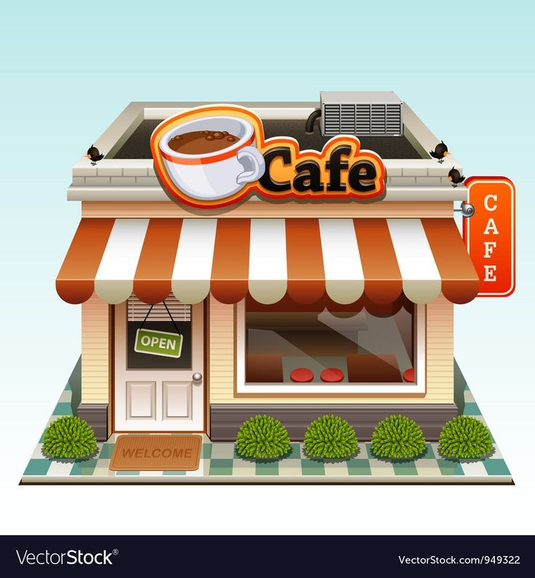
OBJECTIVE
Provide data-driven insights for a new restaurant setup in Bangalore.
SCOPE OF ANALYSIS
Identify suitable locations based on restaurant density, ratings, and customer preferences.
Analyze popular cuisines to align the restaurant's menu with local preferences.
Determine the most suitable restaurant type based on market demand and competition.
Gain insights from customer reviews for improvements and competitive advantage.

Slide 4

Data cleaning
Removing columns
Unnecessary columns (URL, Address, Phone) removed to streamline the dataset.
Focus on relevant data for analysis and decision-making.
Benefits
Reduced dataset size for faster processing.
Eliminated redundant information for clarity.
Enhanced data quality for accurate insights.

Slide 5

Removing Duplicates and Null Values
Removing Duplicates:
Identified and eliminated duplicate rows from the dataset.
Ensured data accuracy and consistency in analysis.
Handling Null Values:
Replaced null values with appropriate measures (e.g., mean) to maintain data integrity.
Minimized data gaps for comprehensive insights.
Impact:
Cleaned dataset for reliable and unbiased analysis.
Reduced potential errors in decision-making.
Enhanced data completeness for meaningful conclusions.

Slide 6
Renaming Columns
Column Renaming:
Columns "listed_in(type)" and "listed_in(city)" have been renamed as "Type" and "City," respectively.
Improved column names for better data comprehension.
Benefits
Enhanced data clarity and understanding.
Facilitated easier data exploration and analysis.
Improved user experience and ease of interpretation.

Slide 7
Column-Wise Analysis
Common Analysis Approach:
Each column examined to understand its characteristics.
Top values emphasized, while less frequent values grouped as 'Others' for simplicity.
Method for 'Others':
Low-frequency values consolidated to 'Others' category for a concise analysis.
Impact:
Comprehensive insights into each column's key factors.
Focus on prominent data points for informed decision-making.
Reduced clutter in visualizations for better data interpretation.

Slide 8
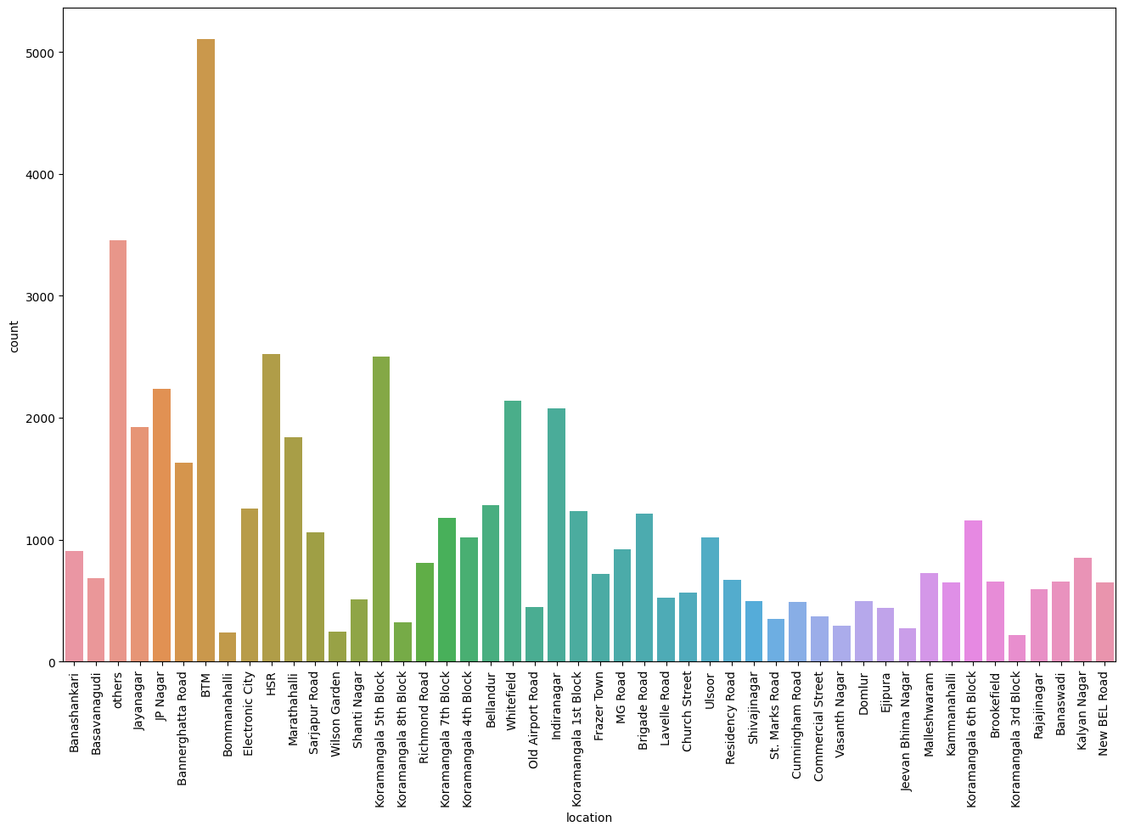
Location-Wise Visualization
Visualization shows the distribution of restaurants across different locations in Bangalore.
BTM has the highest number of restaurants, while Koramangala 3rd block has the lowest.
Insights
BTM is a hotspot for restaurants, indicating high customer footfall and market potential.
Koramangala 3rd block may present an opportunity for the new restaurant to enter a less saturated area.

Slide 9
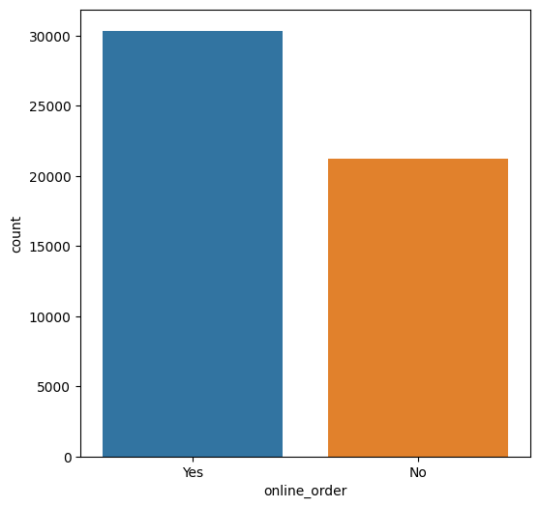
Presence of Online Ordering
Analysis reveals the prevalence of online ordering among restaurants.
Restaurants with online_order feature are somewhat higher in count.
Insight
Online ordering is popular among restaurants, catering to customer convenience and modern dining preferences.

Slide 10
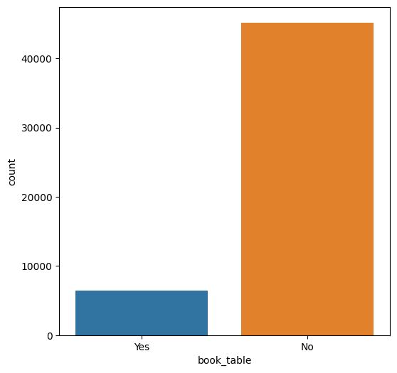
Availability of Table Booking
Investigation shows that table booking facility is available in only a limited number of restaurants.
Insight
Table booking option is relatively scarce among restaurants, potentially leading to customer inconvenience during peak hours.

Slide 11
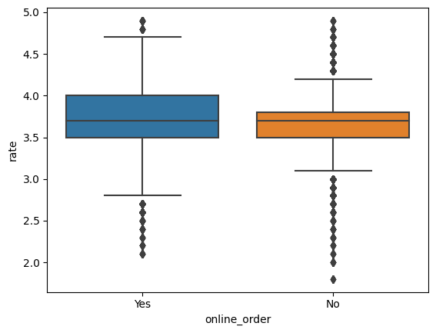
Impact of Online
Ordering on Ratings
Analysis indicates that restaurants offering online ordering tend to have higher ratings compared to those without online ordering.
Insight
Online ordering positively influences customer satisfaction, reflected in higher ratings.

Slide 12
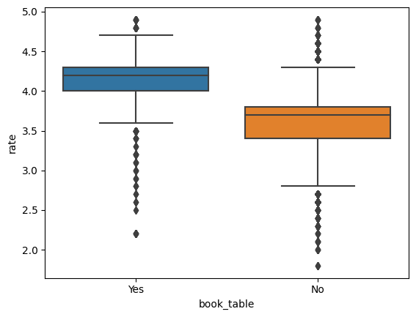
Impact of Table
Booking on Ratings
Analysis reveals a significant impact of table booking facility on restaurant ratings.
Restaurants offering table booking receive higher average ratings, indicating enhanced customer satisfaction.
Insight
Table booking feature positively influences customer perception and overall restaurant experience.

Slide 13
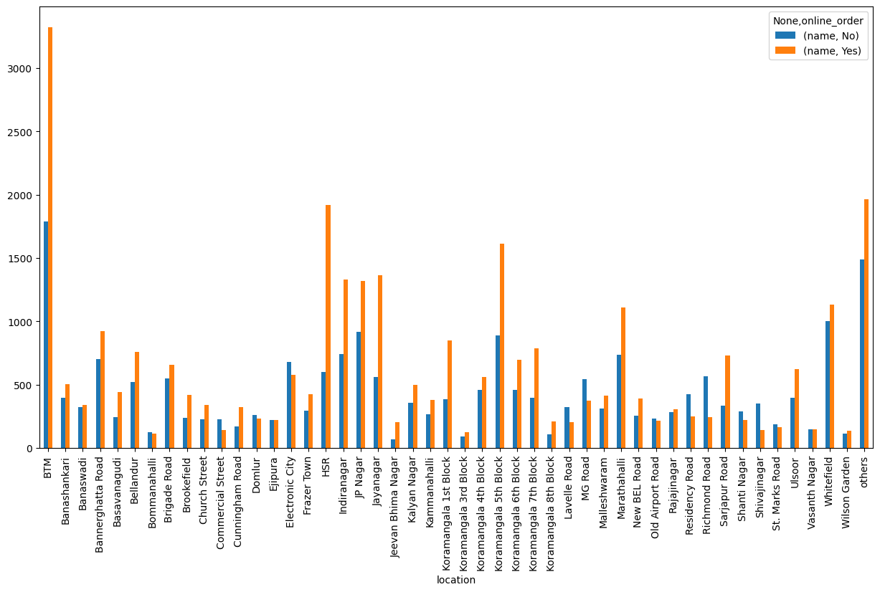
Location-Wise Presence of Online Ordering
Visualization depicts the distribution of restaurants with and without online ordering across various locations in Bangalore.
Noticeable differences observed in BTM, HSR, and Koramangala 5th block, where more restaurants offer online ordering.
In contrast, locations like Electronic City and Richmond Road have a higher proportion of restaurants without online ordering.
Insights
BTM, HSR, and Koramangala 5th block are prime areas for online ordering restaurants, indicating high demand for delivery services.
Electronic City and Richmond Road present opportunities for online ordering expansion to cater to untapped markets.

Slide 14
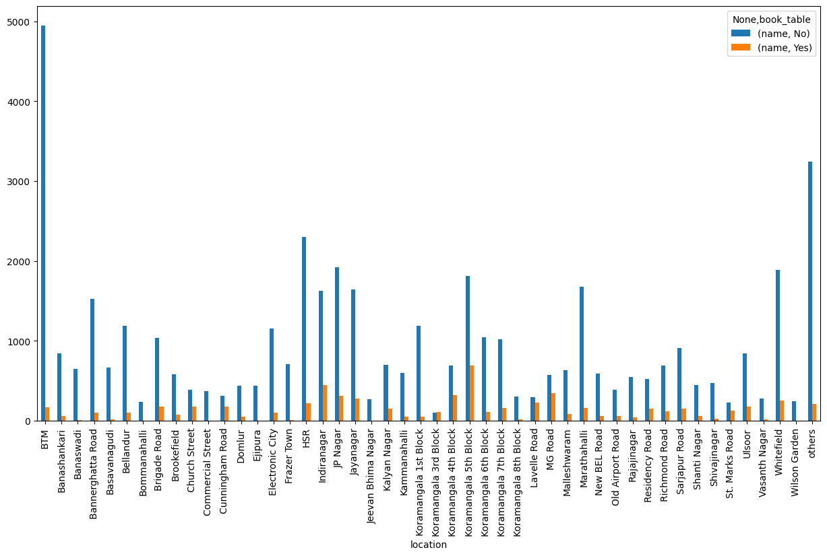
Location-Wise Presence of Table Booking
Visualization illustrates the distribution of restaurants with and without table booking across different locations in Bangalore.
Table booking facility is generally limited across all places.
Koramangala blocks stand out with a relatively higher number of restaurants offering table booking, while Banaswadi and Shivaji Nagar lack this feature entirely.
Insights
Table booking is an opportunity for differentiation and improved customer service in all locations.
Implementing table booking can yield advantages in terms of customer satisfaction and overall restaurant experience.

Slide 15
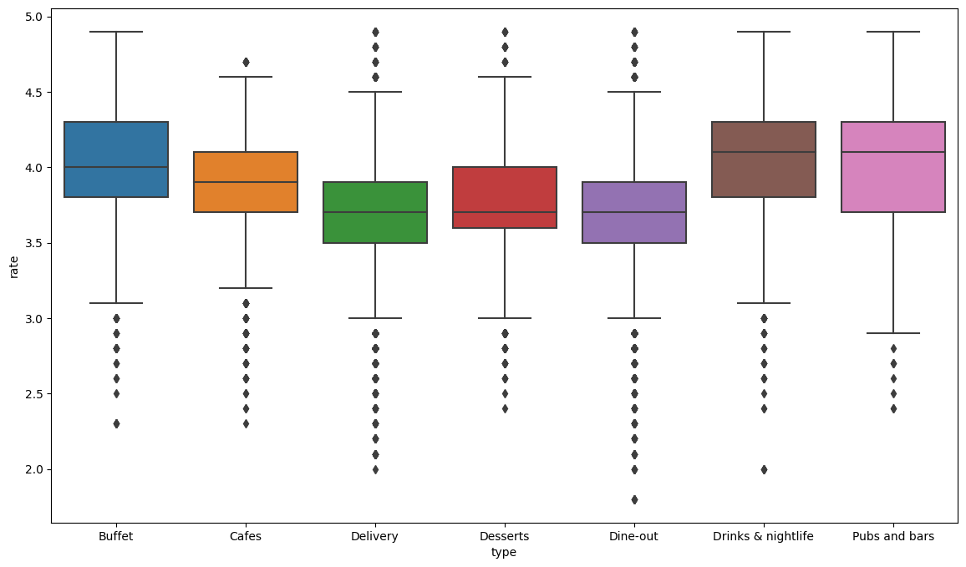
Rating of Restaurants
by Type
Analysis presents the average ratings of restaurants categorized by type.
Drink & night life, pubs, and bars demonstrate the highest average ratings, indicating positive customer feedback.
Desserts and dine-out type restaurants have the lowest average ratings.
Insights
Drink & night life, pubs, and bars tend to provide exceptional customer experiences, reflected in their high ratings.
Desserts and dine-out type restaurants may require attention to enhance customer satisfaction and improve ratings.

Slide 16
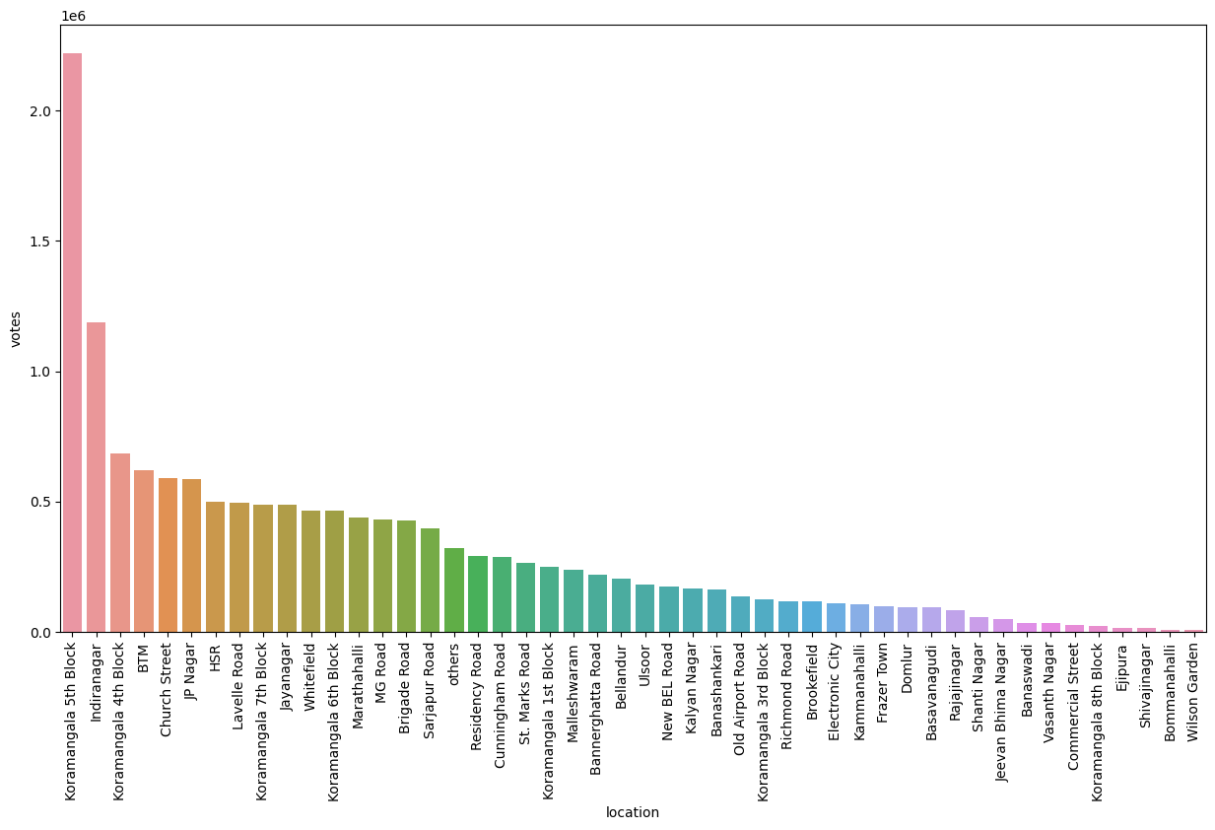
Location-Wise Number of Votes
Visualization illustrates the number of votes received by restaurants in different locations across Bangalore.
Koramangala 5th block stands out with the highest number of votes, indicating active customer engagement.
Indira Nagar follows closely with substantial votes, reflecting customer satisfaction.
Wilson Garden and Bommanahalli have comparatively fewer votes, suggesting potential areas for increased customer engagement.
Insights
High votes in Koramangala 5th block and Indira Nagar indicate strong customer support and loyalty.
Low votes in Wilson Garden and Bommanahalli may signify opportunities to enhance customer interaction and feedback collection.

Slide 17
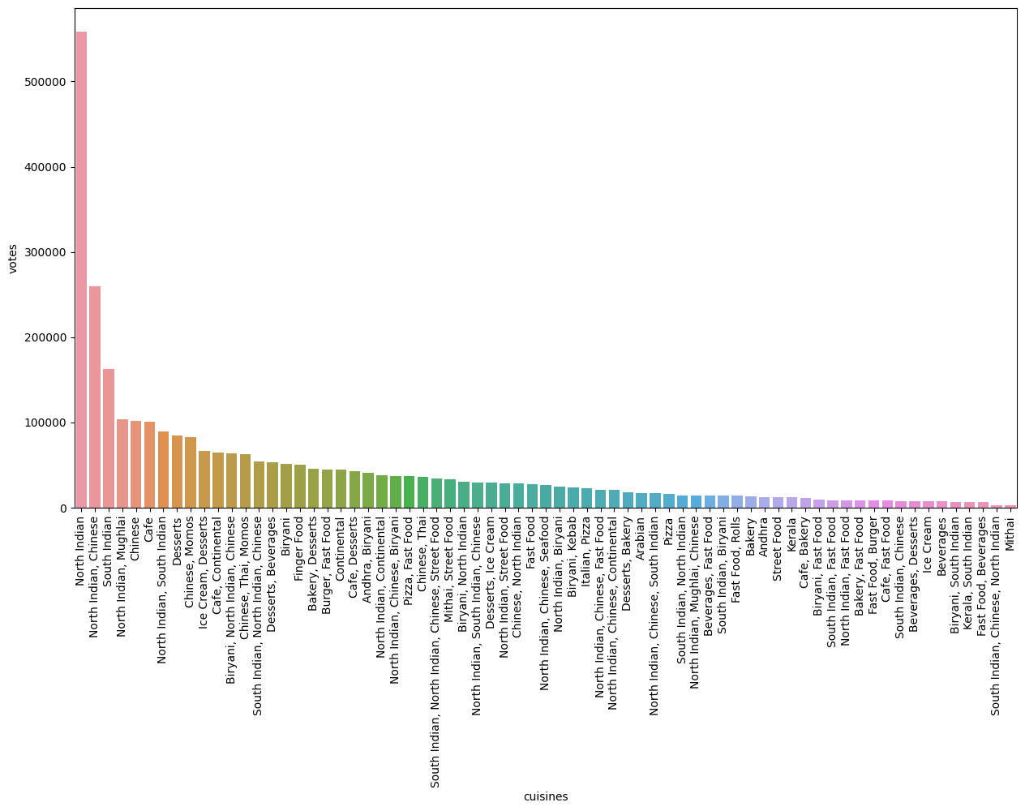
Cuisines by Votes
Analysis reveals the distribution of votes across different cuisines offered by restaurants.
North Indian cuisine peaks in popularity, followed by South Indian and Chinese cuisines.
Beverages and Mithai (sweets) cuisines receive relatively fewer votes, indicating lower preference.
Insights
North Indian cuisine holds strong appeal among customers, garnering the highest votes.
South Indian and Chinese cuisines also enjoy significant popularity, reflecting diverse culinary preferences.
Lower votes for Beverages and Mithai cuisines may warrant attention to improve customer interest.

Slide 18
Key Insights
Location Matters: BTM, HSR, and Koramangala 5th block show high restaurant density, making them potential hotspots for the new restaurant setup.
Online Ordering Impact: Restaurants with online ordering tend to receive higher ratings, indicating its positive influence on customer satisfaction.
Table Booking Advantage: Offering table booking improves average ratings, providing a competitive edge and enhancing customer experience.
Cuisine Preferences: North Indian, South Indian, and Chinese cuisines are popular choices, while Beverages and Mithai receive comparatively lower votes.
Customer Engagement: Encourage customer engagement through loyalty programs, feedback collection, and personalized services.

Slide 19
Key Insights (Continued)
Location-Specific Strategies: Tailor strategies based on location insights to meet local preferences and market demands.
Competitive Opportunities: Identify gaps in underserved locations like Banaswadi and explore unique selling propositions for differentiation.
Menu Enhancement: Curate a diverse and appealing menu based on popular cuisines to cater to varied customer tastes.
Online Presence: Establish a strong online presence with user-friendly ordering and reservation systems to drive customer convenience.
Continuous Improvement: Focus on continuous improvement based on customer feedback and market trends for sustained success.

Slide 20
Recommendations
Location Selection: Choose a strategic location in high-density areas like BTM, HSR, or Koramangala 5th block to capitalize on customer footfall and demand.
Cuisine Focus: Emphasize popular cuisines such as North Indian, South Indian, and Chinese to cater to customer preferences and drive higher votes.
Online Ordering & Table Booking: Offer online ordering and table booking facilities to enhance customer convenience, increase ratings, and improve overall customer experience.
Explore Untapped Markets: Explore opportunities in underserved locations like Banaswadi to establish a unique market presence, gain a competitive advantage, and attract new customers.
Restaurant Type: Based on the analysis, consider pubs and bars that is with market demand. Also make sure that you are expertise in that type.

Slide 21
Strategies
Customer-Centric Approach: Prioritize exceptional customer service, personalized interactions, and timely feedback collection to build customer loyalty.
Diverse Menu Selection: Curate a diverse menu with innovative dishes, daily specials, and seasonal offerings to attract repeat customers and keep the menu fresh.
Online Presence & Marketing: Establish a strong online presence with an engaging website, active social media presence, and targeted marketing campaigns to reach a wider audience.
Quality Assurance: Ensure consistent food quality, hygiene standards, and presentation to deliver an unforgettable dining experience.
Continuous Improvement: Regularly solicit feedback from customers, analyze market trends, and adapt the restaurant's offerings and services to meet evolving customer demands.

Slide 22
Unique Strategies
Theme-Based Dining Experience: Introduce a captivating theme or concept that sets the restaurant apart, creating a memorable and immersive dining experience for customers.
Seasonal Pop-Up Menus: Introduce seasonal pop-up menus that celebrate festivals or special occasions, providing limited-time offerings to pique customer interest.
Community Engagement: Partner with local organizations, schools, or charities for community events, promoting social responsibility and building a positive brand image.
Online Food Challenges: Create exciting food challenges or contests that go viral on social media, encouraging customers to participate and attract a wider audience.
Interactive Food Stations: Implement interactive food stations where customers can customize their dishes, fostering engagement and a sense of culinary adventure.

Slide 23

Conclusion
Strategic location selection (BTM, HSR, Koramangala 5th block) maximizes customer flow.
Focus on popular cuisines (North Indian, South Indian, Chinese) to cater to diverse preferences.
Implement online ordering and table booking for convenience and higher ratings.
Unique dining experiences, sustainable practices, and a strong online presence set the restaurant apart.
Continuous improvement and effective marketing strategies are vital for sustained success.

Slide 24
Thank You for Watching

